Slide 1
< PROJECT TITLE >
EMPLOYEE NiTIn EXPENSES DETAILS
By, N.Nikitha

Slide 2
First, analyse the data for the month of June. You need to open the excel file and refer to the expense details
What is the problem?
Who has this problem?
The project analysis his expenses to identify where most of the money is spent.
The objective is to identify unnecessary expenses and suggest ways to increase savings
How will I know this problem has been solved?
June month expense data
Nitin works as a graphic Designer and earns rupees15,000 per month. He wants to buy a scooter for his daily commute but has not been able to save

Slide 3
PROJECT APPROACH
Part 1: Analyse expense details for June using pivot Tables, Pivot charts and Data Bar
Part 2: Analyse expense details for the last 6 Months using monthly and category wise Pivot Tables and charts.
Compare categories and items to identify major and less-essential spending areas.
Use the findings to provide practical recommendations for increasing savings

Slide 4
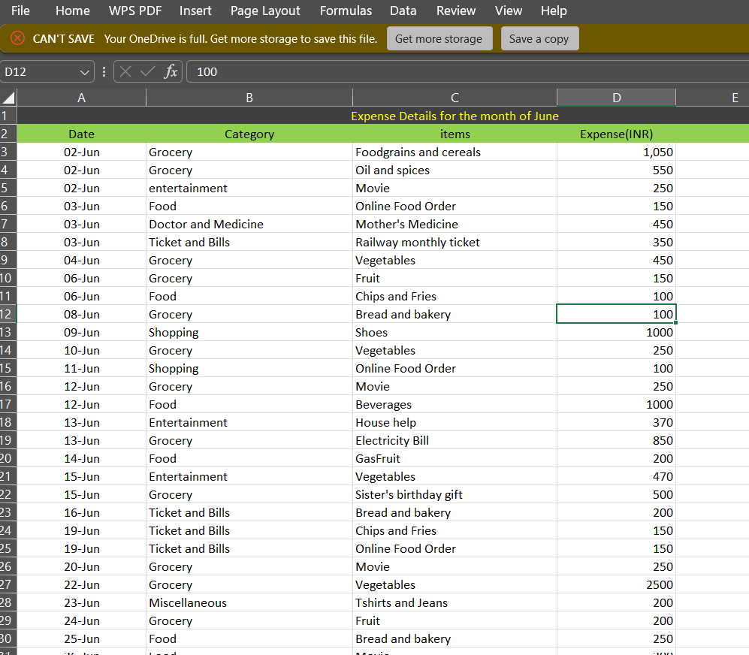
Part 1-June expense data
The data contains Date, Category, Item and expense(INR).
Examples include Grocery, Food, Entertainment, Shopping and Ticket & Bills

Slide 5
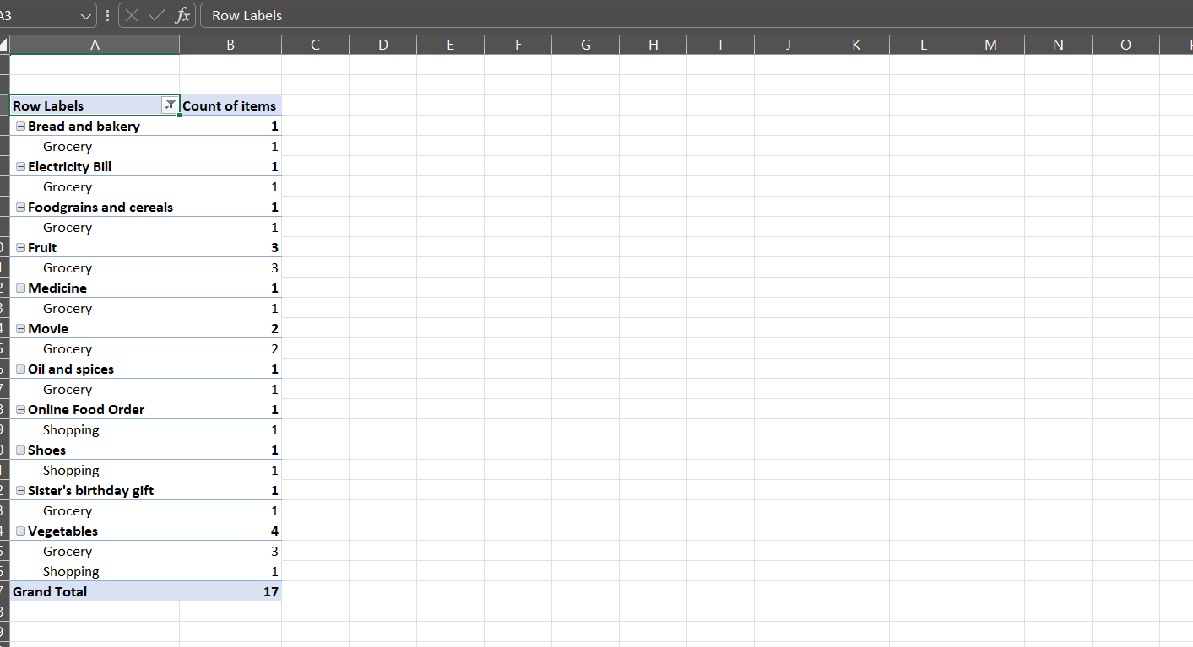
Part 1-Item Frequency Analysis
Grand Total shown in the Pivot Table:17 item occurrences
Online Food Order appears 1 time in the provided Pivot.
Movie appears 2 times in the provided Pivot.
Vegetables appears 4 times, the highest item frequency shown.
This frequency analysis supports the part 1 task on item counts.

Slide 6
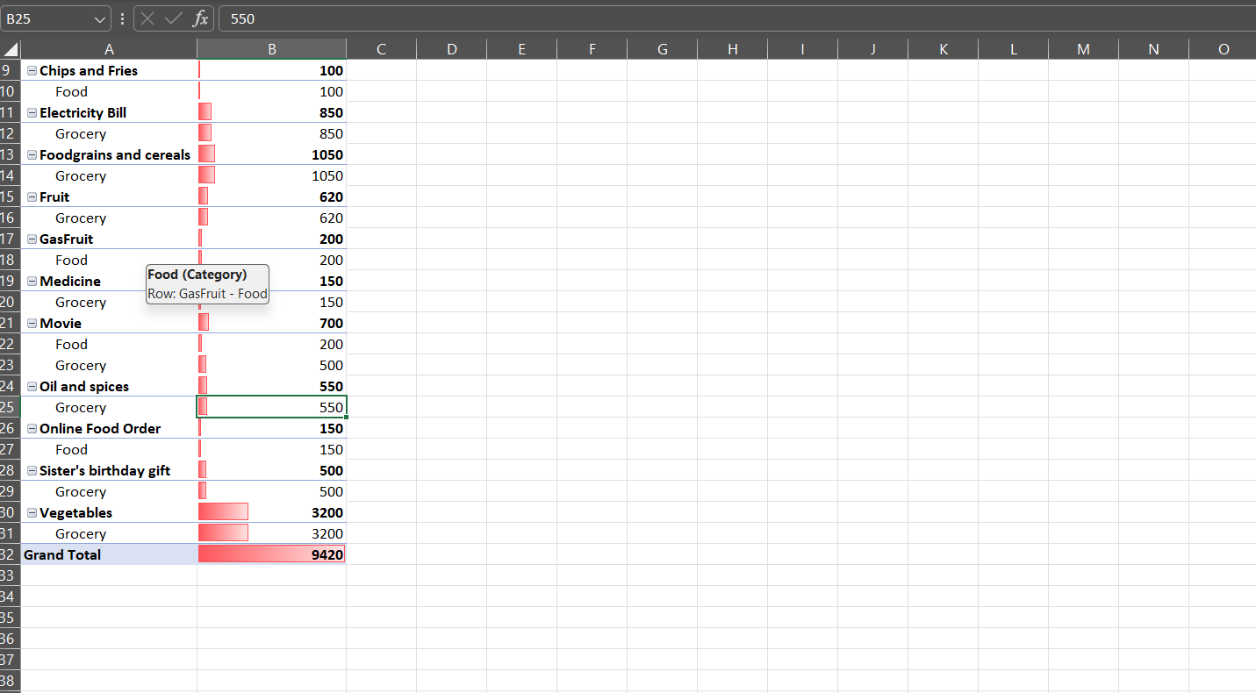
Part 1- Item-wise expense analysis
Grand Total displayed : 9,420.
Vegetables : 3,200.
Foodgrains and cereals : 1,050.
Electricity Bill : 850.
The data bars make higher-spend items easy to identify.

Slide 7
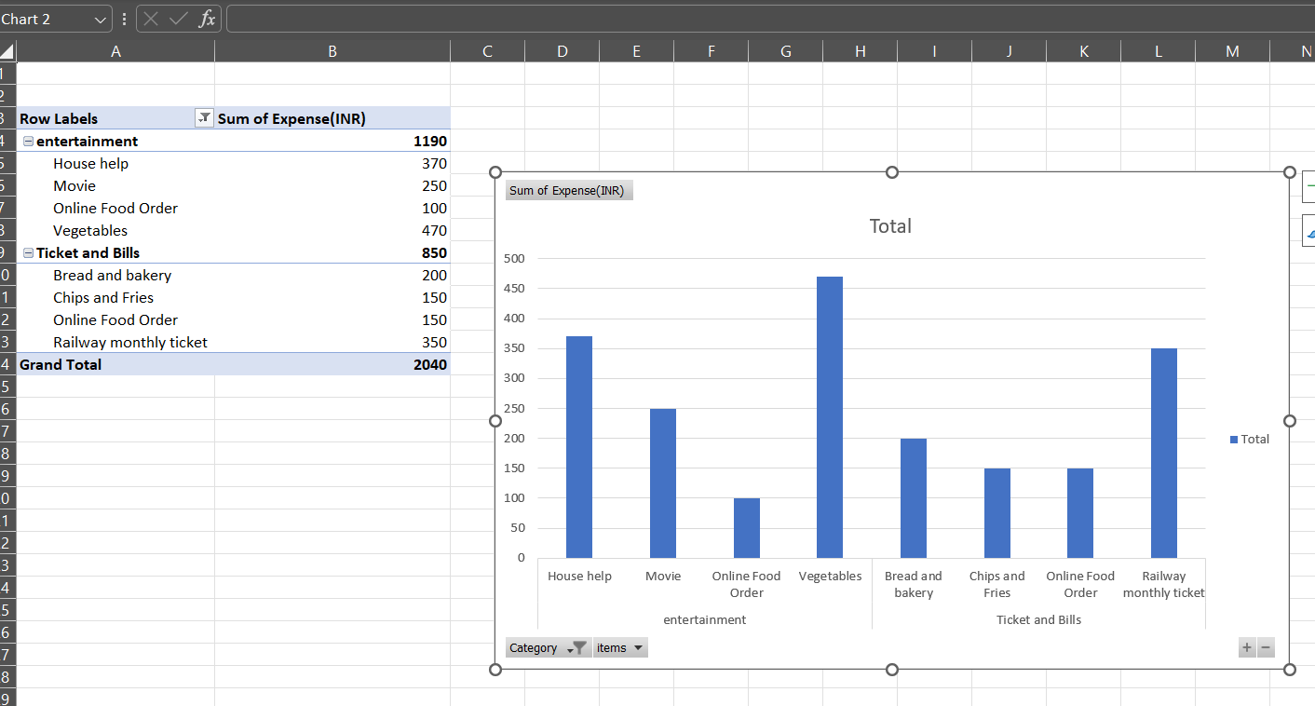
Part 1-item-wise expense analysis
  Cho
Entertainment Totals = 1,190
Ticket and Bills Total = 850
Combained amount shown in the pivot table = 2,040
Vegetables under Entertainment has the highest visible amount of 470

Slide 8
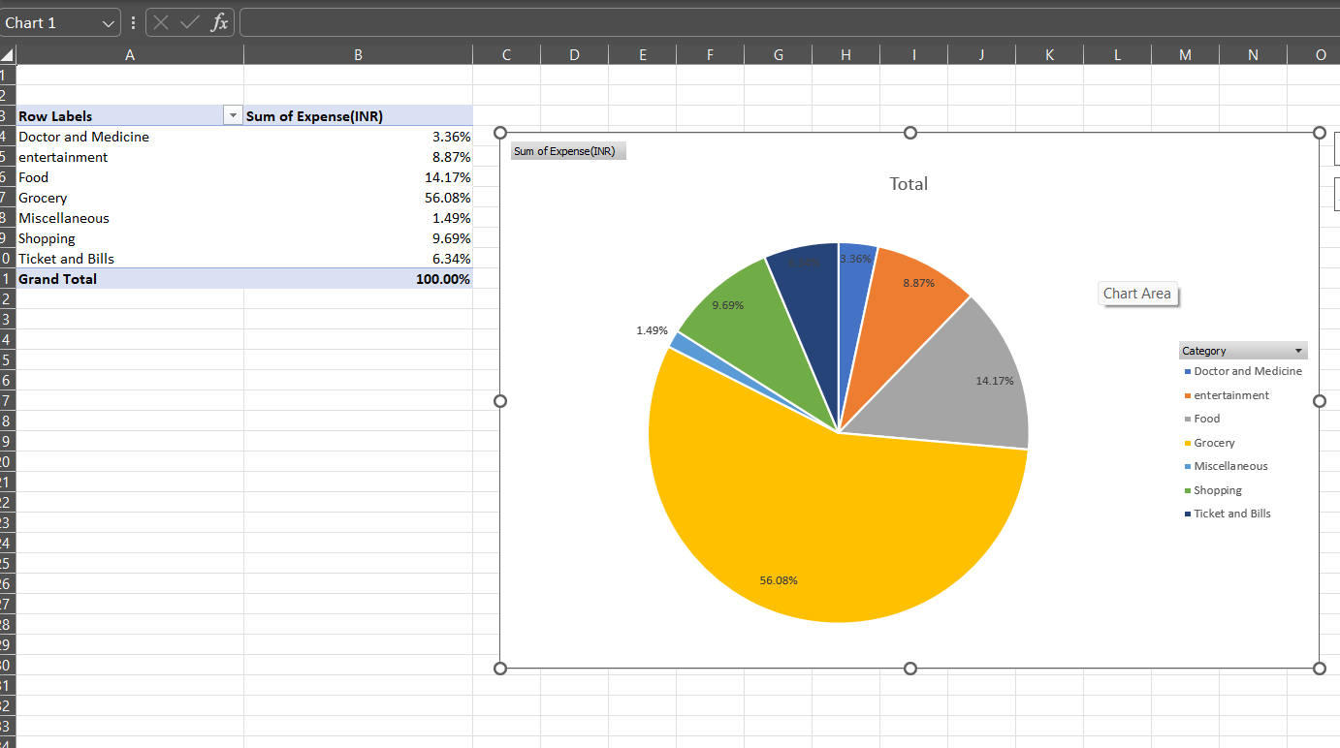
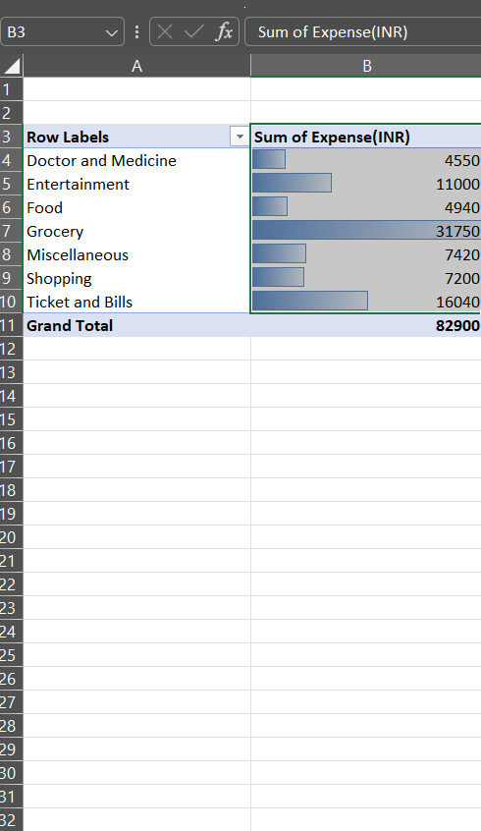
Part 2- Overall category expense analysis
Grocery 31,750.
Ticket and Bills 16,040
Entertainment 11,000

Slide 9
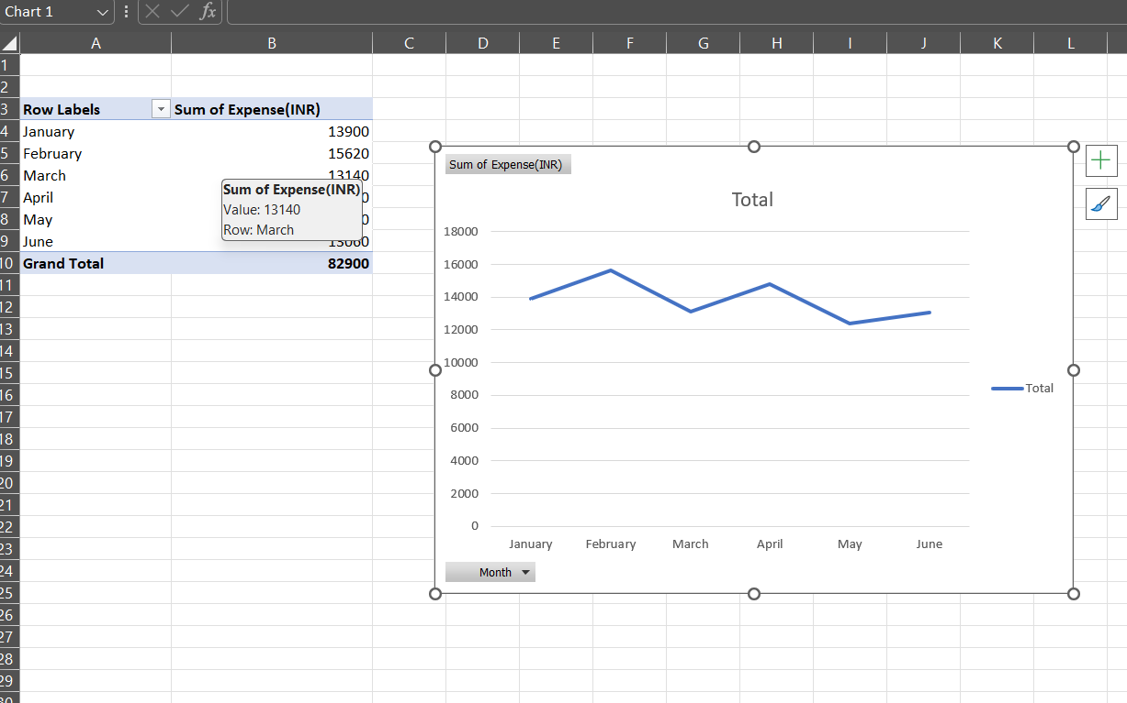
Part 2-Month-wise expense trend
  January = 13,900
  February = 15,620-highest month he spent
  March = 13,140
  April = 14,800
  May = 12,380
  June = 13,060

Slide 10
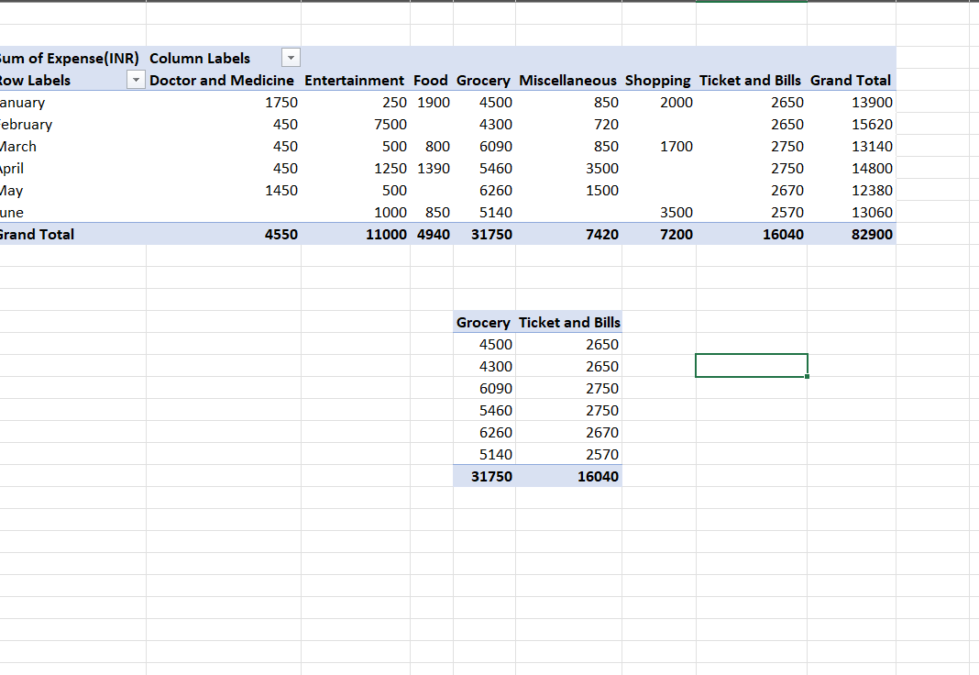
Part 2- category-wise expenses by month
  Grocery is the largest in the Pivot Table : 31,750.
  Ticket and Bills is the next largest overall Category : 16,040.
  The table compares category spending across all six months.

Slide 11
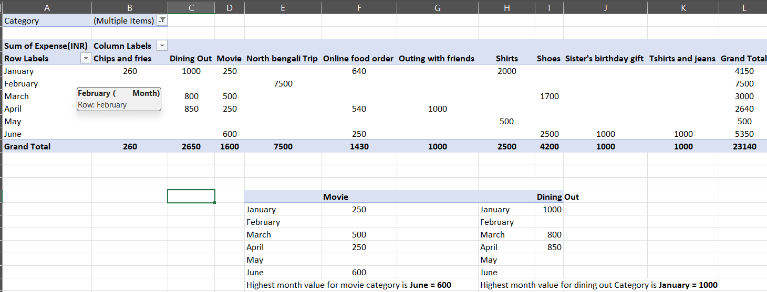
Part 2- entertainment, Food & shopping items
Movie spending is highest in June : 600.
Dinning Out spending is highest in January : 1000.
Movie totals shown : Jan =250, Mar=500, Apr=250, Jun=600.
Dinning Out totals shown : Jan=1000, Mar=800, Apr=850.

Slide 12
Key findings
June item-wise analysis shoes 2,040 combined for Entertainment and Ticket and Bills.
Across six months, February has the highest total expense at 15,620.
Grocery is the largest overall category in the six-month category Pivot Table.
Movie spending is highest in June at 600; Dining Out is highest in January at 1000.
The analysis highlights areas that can be reviewed for possible savings.

Slide 13
Recommendations to increase savings
Set a monthly limit for discretionary spending such as movies, dining out and shopping.
Track grocery and other high-value categories regularly and avoid unnecessary purchases.
Plan online food orders and dining out in advance to reduce frequent spending.
Review spending every month using the same Pivot Table approach and set a fixed savings target.
Use the saved amount toward Nitin’s scooter goal.

Slide 14
conclusion
Pivot Tables and charts were used to analyse June and the last six months.
The analysis identified major spending categories and monthly spending patterns.
The findings can help Nitin identify areas where spending can be reduced.
Reducing unnecessary expenses and following a monthly savings plan can support his scooter goal.

